Slide 1
NLP

Slide 2
Text Similarity
The Vector Space Model

Slide 3
Vectors, Matrices, and Tensors
X = <x₁, x₂, …, x_{n}>: a vector of n dimensions.
x₁, …, x_{n} can take either binary values {0, 1}, or real values
Vectors and matrices provide a natural way to represent the occurrence of words in a document/query.
In text analysis, n is usually the size of the vocabulary, so each dimension corresponds to a unique word
X can be used to represent a document, or a query, or …
So x_{i} indicates either “whether the i-th word in the vocabulary appears” (binary value), or “how many times does the i-th word appear” (real value).
The entire collection is thus represented as a matrix.
How?

Slide 4
Example of Document Vectors
Doc 1= “information retrieval”
Doc 2 = “computer information retrieval”
Doc 3 = “computer retrieval”
Vocabulary: information, retrieval, computer
Doc 1 = <1, 1, 0>
Doc 2 = <1, 1, 1>
Doc 3 = <0, 1, 1>
information, retrieval, computer
1 | 1 | 0
1 | 1 | 1
0 | 1 | 1
D =
Question: Doc 4 = “retrieval information retrieval” ?

Slide 5
Documents in a Vector Space
Doc 1= “information retrieval”
Doc 2 = “computer information retrieval”
Doc 3 = “computer retrieval”
Vocabulary: information, retrieval, computer
Doc 1 = <1, 1, 0>
Term 1: information
Doc 1
Term 2: retrieval
Term 3: computer

Slide 6
Relevance as Vector Similarities
Doc 1= “information retrieval”
Doc 2 = “computer information retrieval”
Doc 3 = “computer retrieval”
Term 1: information
Doc 1
Doc 2
Term 2: retrieval
Which document is closer to Doc 1? Doc 2 or Doc 3?
What if we have a query “retrieval”?
Doc 3
Term 3: computer

Slide 7
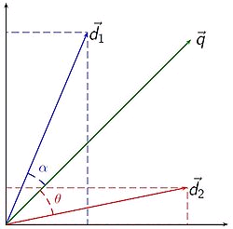
Document Similarity
Used in information retrieval to determine which document (d₁ or d₂) is more similar to a given query q.
Documents and queries are represented in the same space.
Angle (or cosine) is a proxy for similarity between two vectors

Slide 8
Distance/Similarity Calculation
The similarity/relevance of two vectors can be calculated based on distance/similarity measures
S: X, Y → (0, 1)
X: <x₁, x₂, …, x_{n}>
Y: <y₁, y₂, …, y_{n}>
S(X, Y) = ?
The more dimensions in common, the larger the similarity
What about real values?
Normalization needed.

Slide 9
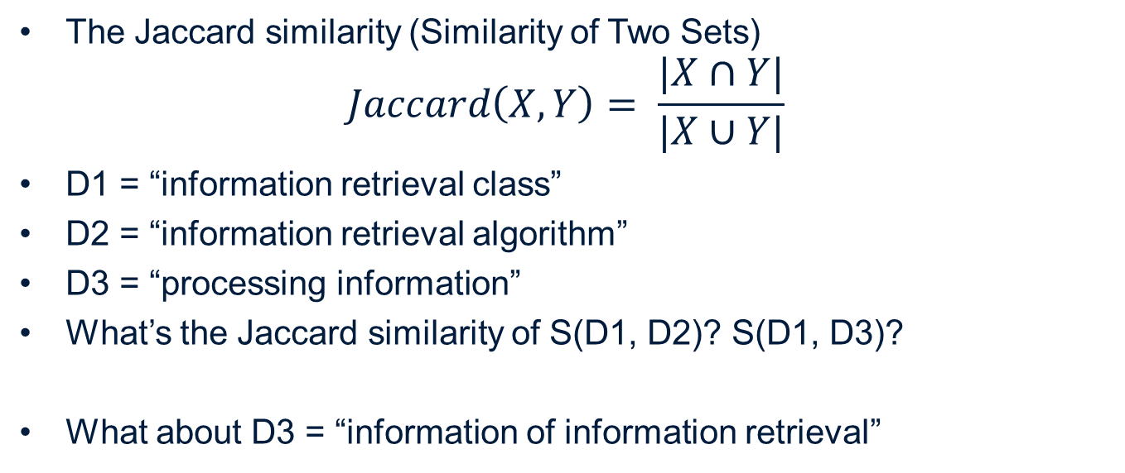
Similarity Measures
The Jaccard similarity (Similarity of Two Sets)
$$Jaccard\left(X,Y\right)= \frac{|X∩Y|}{|X∪Y|}$$
D1 = “information retrieval class”
D2 = “information retrieval algorithm”
D3 = “processing information”
What’s the Jaccard similarity of S(D1, D2)? S(D1, D3)?
What about D3 = “information of information retrieval”

Slide 10
Similarity Measures
Euclidean Distance – distance of two points
Z
X
Y

Slide 11
Similarity Measures (Cont.)
Cosine similarity: similarity of two vectors, normalized
X
Which one do you think is suitable for retrieval?
Jaccard? Euclidean? Cosine?
Y

Slide 12
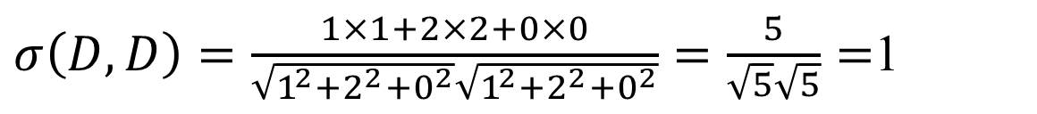
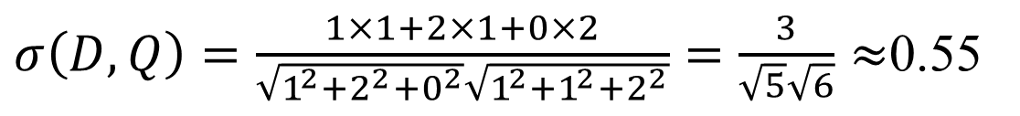
Example
What is the cosine similarity between:
D= “cat,dog,dog” = <1,2,0>
Q= “cat,dog,mouse,mouse” = <1,1,2>
Answer:
In comparison:
$σ\left(D,Q\right)=\frac{1×1+2×1+0×2}{\sqrt{1^{2}+2^{2}+0^{2}}\sqrt{1^{2}+1^{2}+2^{2}}}=\frac{3}{\sqrt{5}\sqrt{6}}≈$0.55
$σ\left(D,D\right)=\frac{1×1+2×2+0×0}{\sqrt{1^{2}+2^{2}+0^{2}}\sqrt{1^{2}+2^{2}+0^{2}}}=\frac{5}{\sqrt{5}\sqrt{5}}=$1

Slide 13
Quiz
Given three documents
D₁ = <1,3>
D₂ = <10,30>
D₃ = <3,1>
Compute the cosine scores
σ(D₁,D₂)
σ(D₁,D₃)
What do the numbers tell you?

Slide 14
Answers to the Quiz
σ(D₁,D₂) = 1
one of the two documents is a scaled version of the other
σ(D₁,D₃) = 0.6
swapping the two dimensions results in a lower similarity

Slide 15
Quiz
What is the range of values that the cosine scores can take?

Slide 16
Answer to the Quiz
Mathematically, the cosine function has a range of [-1,1]
However, when the two vectors are both in the first quadrant (since all word counts are non-negative), the range is [0,1]
For word embeddings, the range is [-1,1] (since the values don’t have to be non-negative)

Slide 17
NLP

